Slide 1
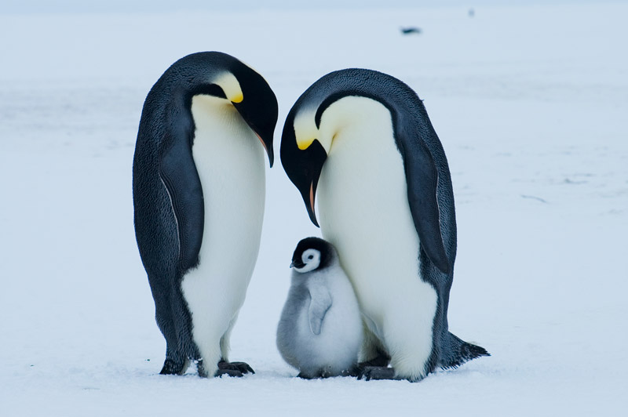
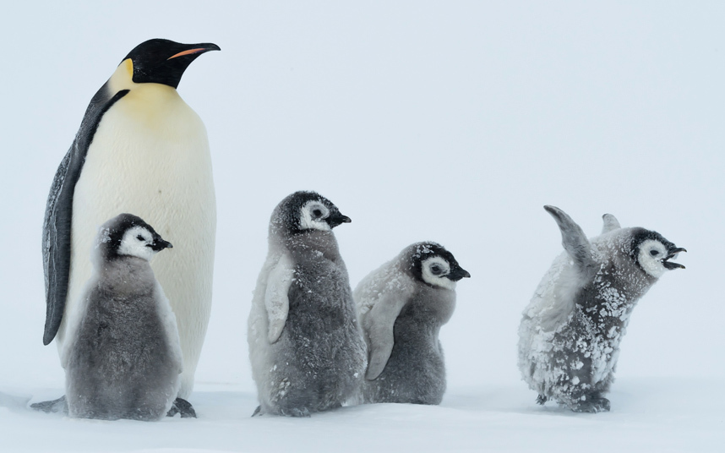
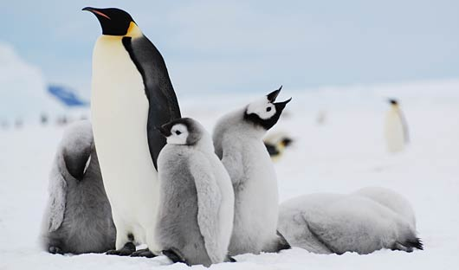
The Inquiry of Emperor Penguin and Antarctica. By : Uike Filiai

Slide 2
Research Question!
How do Emperor Penguin survive in Antarctica?

Slide 3
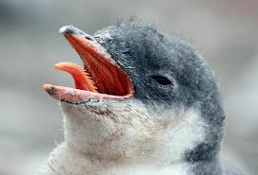
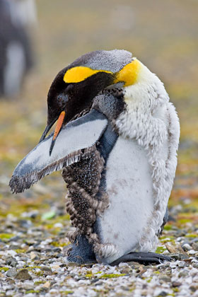
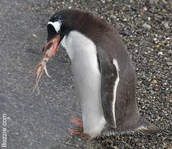
A) Feeding
1) What does emperor penguins eat?
Emperor penguins eat
krill,
fish, squid and crustaceans.
they also have very rough and
spiky tongues that can grip very slippery fish.

Slide 4
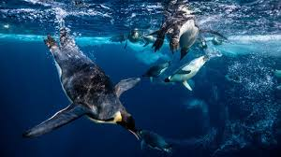
2) How does emperor penguins catch its food?
They can dive under water for 22 minutes without breathing, to catch their food.
They can dive in 550 meters which is 1,800 feet.

Slide 5
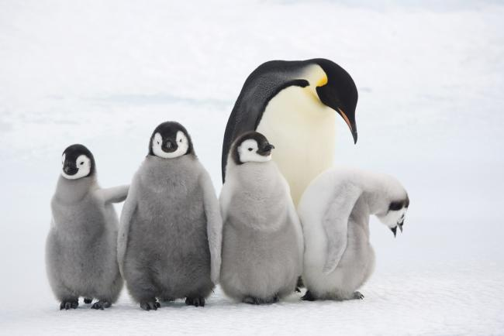
B) Habitat 1)Where does the emperor penguin live?
Emperor penguins live in - Antarctic continent

Slide 6
2)Where does emperor penguins spend its time?
Emperor penguins spend their time -only in Antarctica

Slide 7
3) Does its body vary at different seasons of the year?
Emperor penguins are :-
the tallest and heaviest of all living penguins.
Male and female are actually similar in sizes.
Their length are approximately 122 cm long.
And their weighing are approximately 22 to 45kg

Slide 8
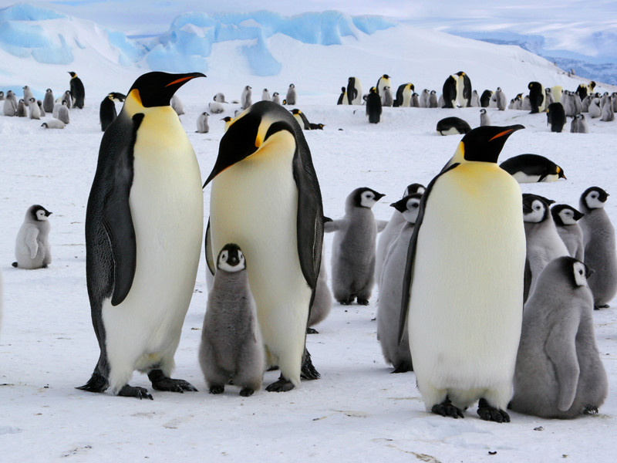
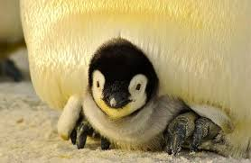
Colours
Their feathers are black from the head down to back.
They both have white belly’s, pale yellow breast and bright yellow ear patch’s.
Emperor penguins live exclusively in Antarctica environment, because they breed during winter, when pack ice freezes and stabilizes

Slide 9
Conclusion
After this research I learnt that the Emperor Penguins can dive in the water for 22 minutes. I also learnt about its feeding and its habitat.
I really enjoyed this research and learning about Antarctica and emperor penguins.
Next time I would like to include an introduction and add a video clip to my presentation to make it more interesting.

